Slide 1


PHILIPPINE MILITARY ACADEMY
RETIREES ASSOCIATION, INC.
Corporate Security as a Business or Profession

Slide 2


CORPORATE SECURITY PROFESSION:
A small step or giant leap?
HERMIE G. COLINA
PMA MAPITAGAN CLASS 1980

Slide 3
Presentation Roadmap
Transitioning from Military to Corporate Sector
Cultural Differences (Military vs Corporate)
Succeeding in the Corporate World as Security Leader
Security as Business Enabler
Cost Centre to Value Generation – Changing the Perception of Security
Security Management Framework – Best Practice

Slide 4
Desired Outcomes
At the end of this Webinar, you would have:
Obtained a clear understanding and appreciation of the skills and experiences that you can bring to the Corporate World.
Gained understanding about the differences between Cultures (Military and Corporate) and how to navigate them.

Slide 5
Desired Outcomes
Learned how to facilitate a smooth transition and adjustments that need to be made in a corporate environment.
Known the Best Practices on how to become a successful Corporate Security Leader.
Seen a sample Strategic Security Management Framework.

Slide 6

Transitioning from military to corporate sector
“Can be very challenging and frustrating
but with the right mindset, it can be successful and rewarding experience”

Slide 7
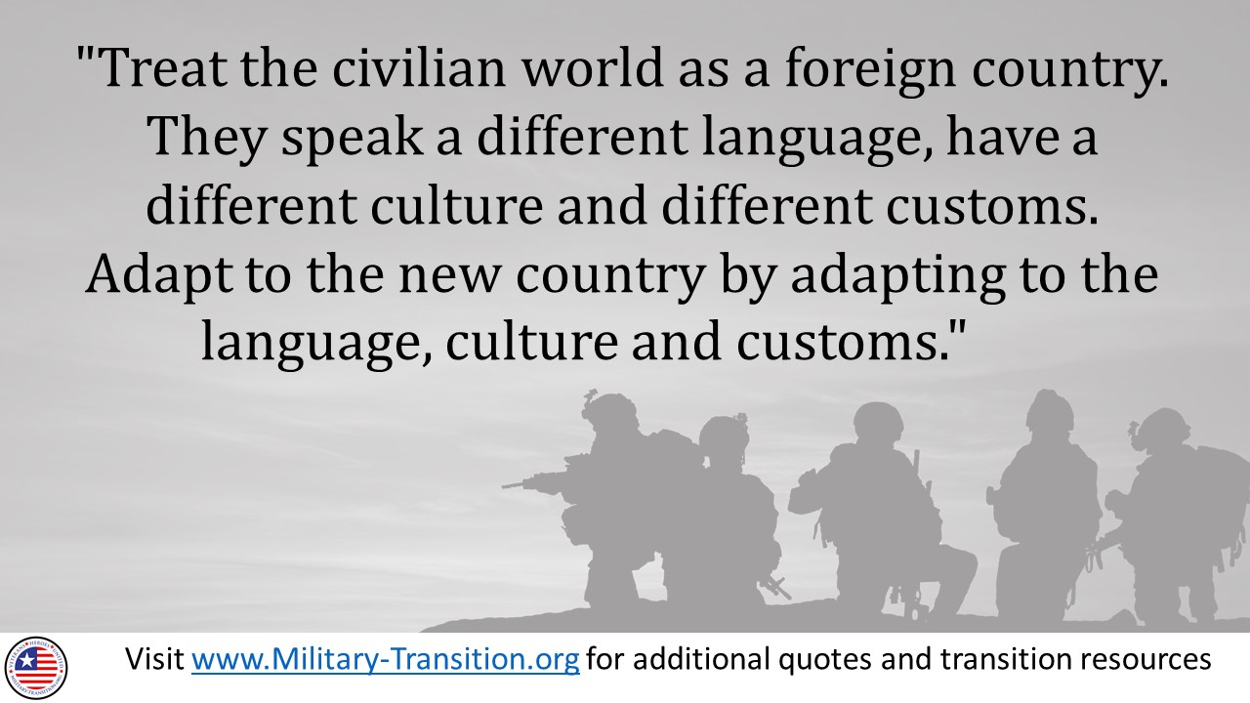
www.military-transition.org

Slide 8
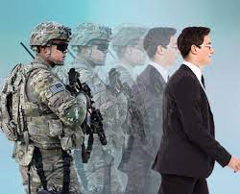
Start Early
Translate Your Skills
Get Certified
Build Your Network
Consider Additional Education
Be Flexible
Understand The Differences
Learn The Language
Adjust to the Work Environment
Emphasize Transferable Skills
Seek Support
PRACTICAL TIPS

Slide 9

CULTURAL DIFFERENCES:
Military vs. Corporate
CULTURAL DIFFERENCES:
Military vs Corporate
Mission
Structure
Leadership
Culture of Risk
Performance Measurement
VALUES GOALS PRACTICES

Slide 10
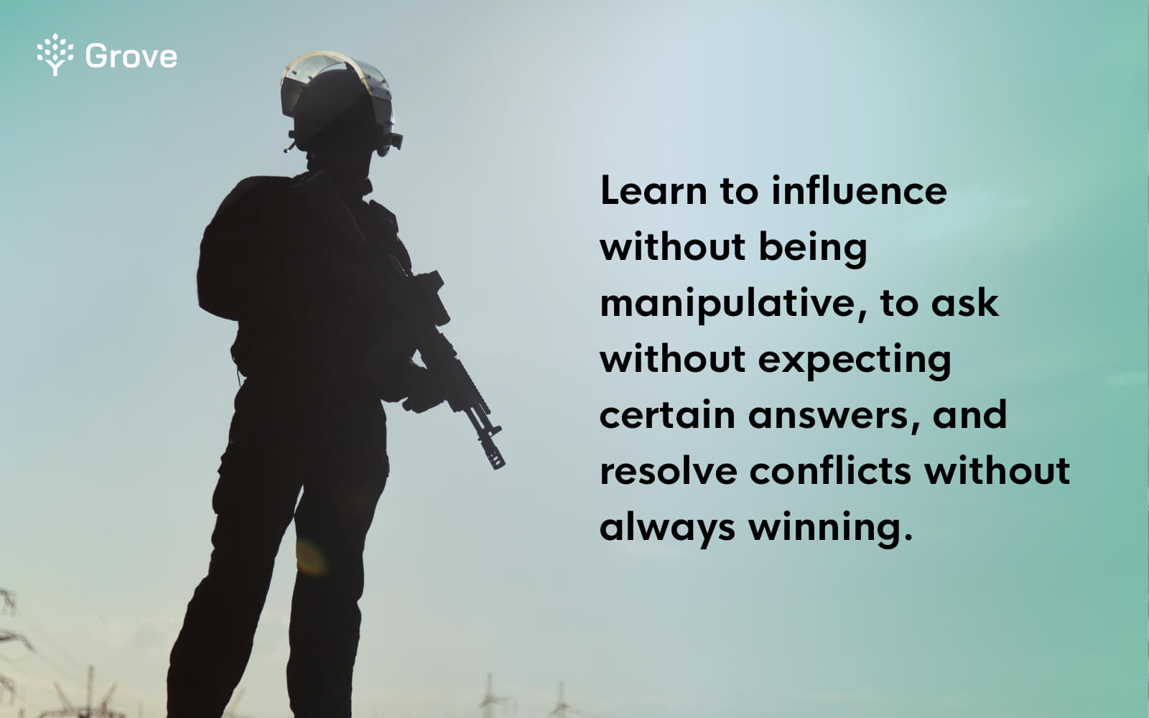
What does good military leadership teach us about HR?

Slide 11
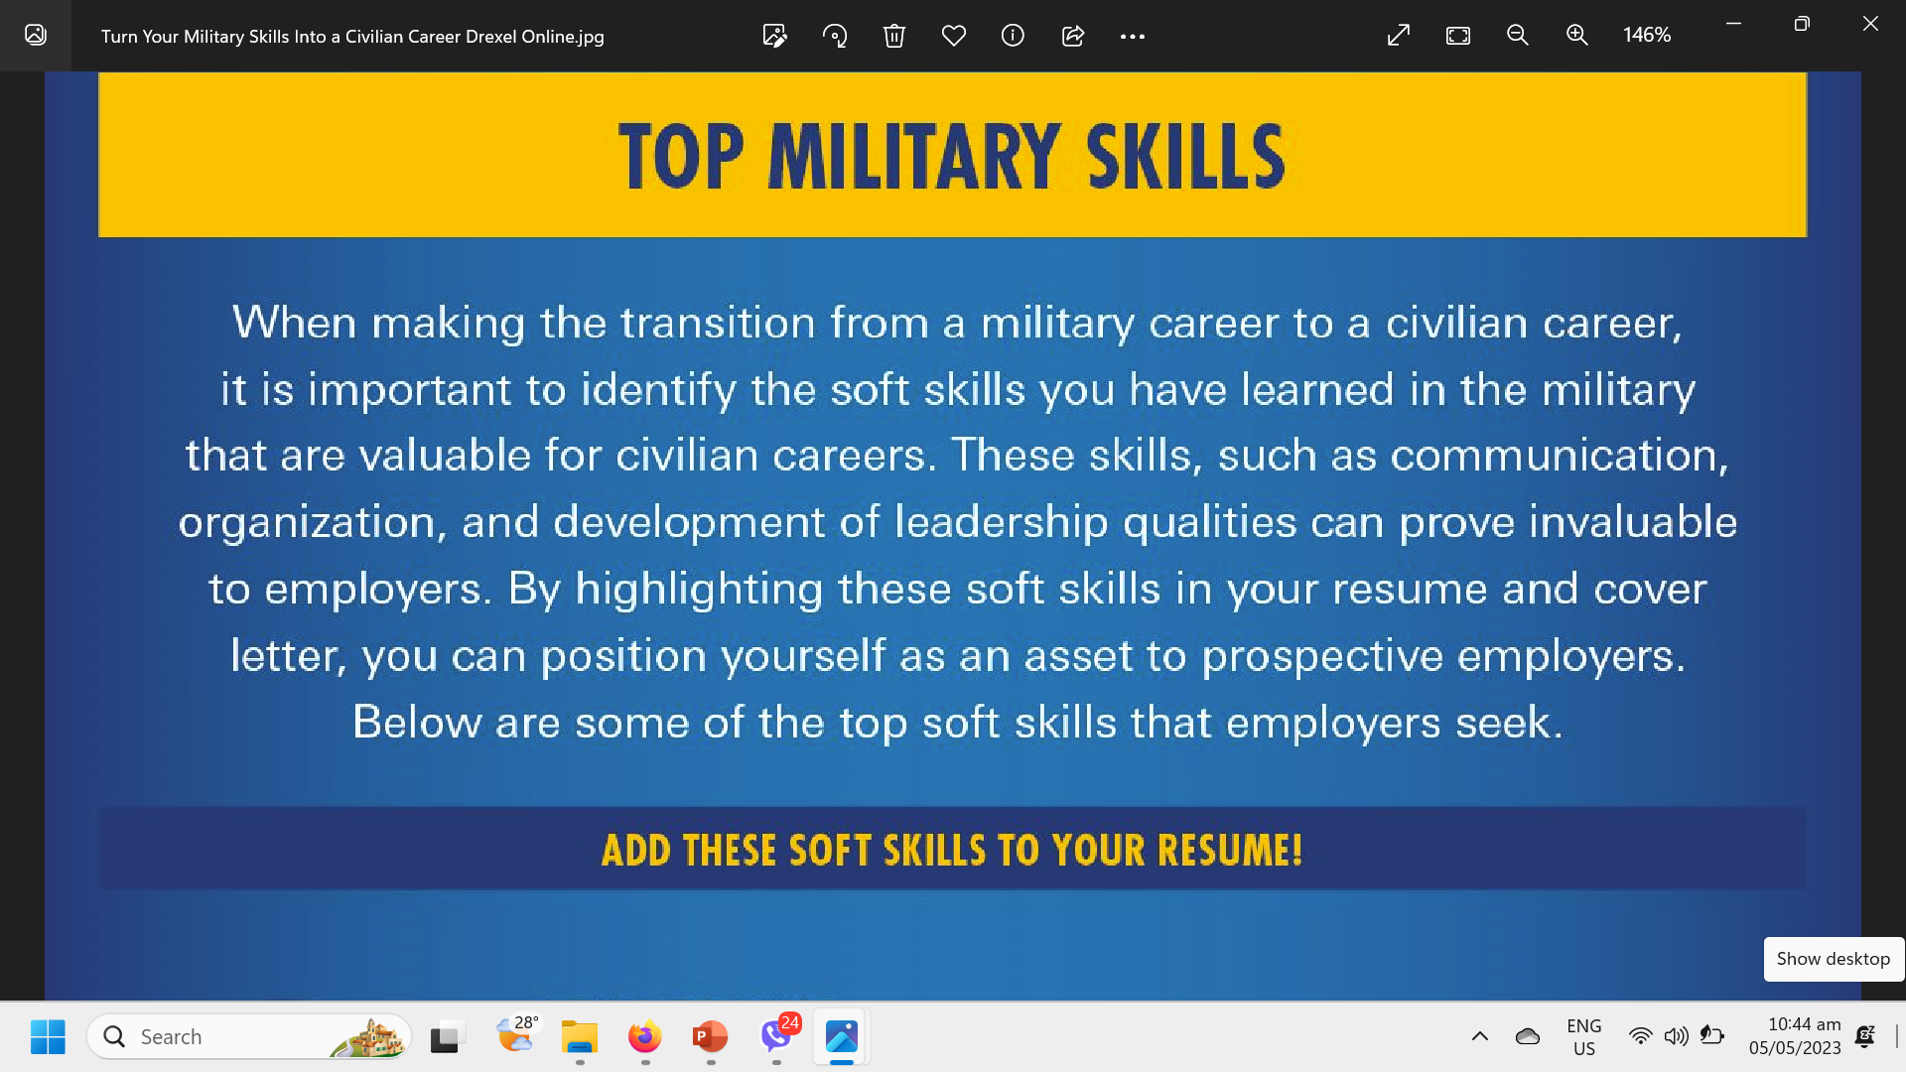

Slide 12
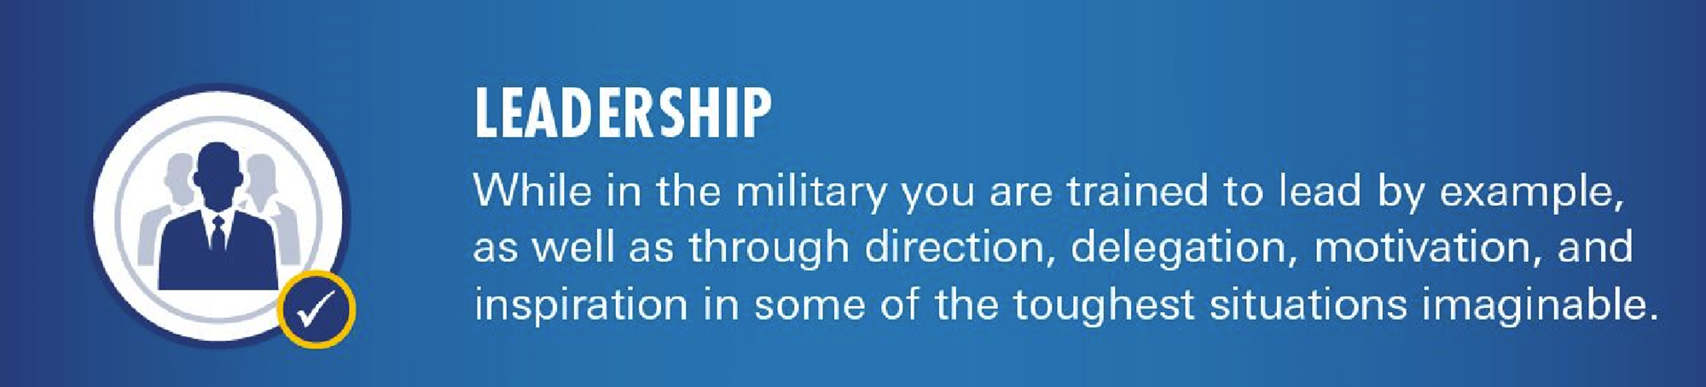


Slide 13
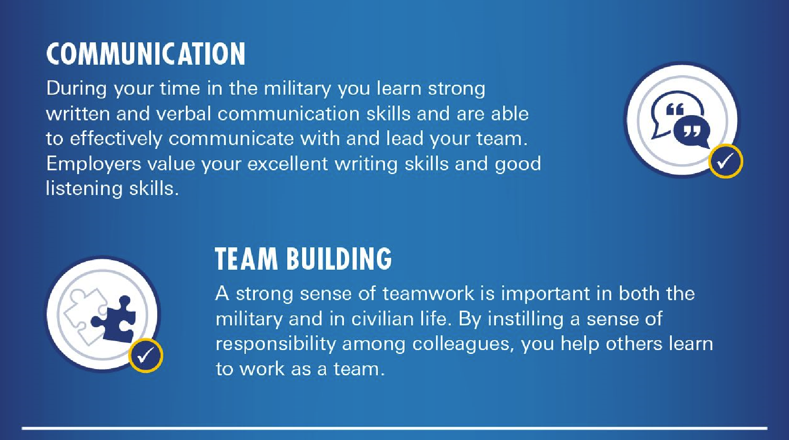

Slide 14
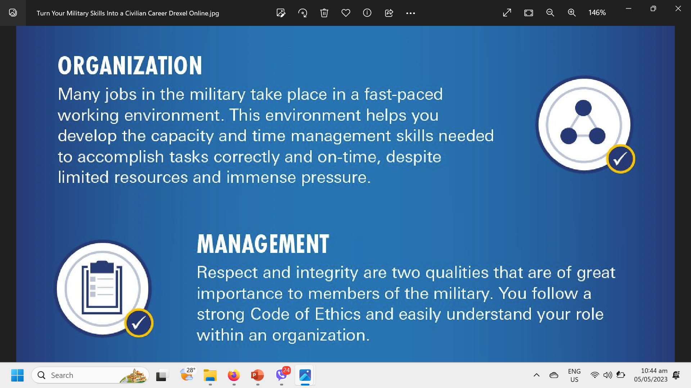

Slide 15
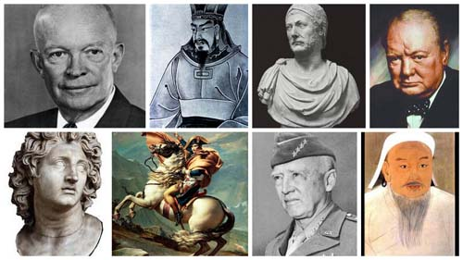
BEST PRACTICES in Corporate Security As a Leader
Internal Awareness
Clarity
Walk and Talk
Take Initiative
        Common Language/Communicate Effectively
        Adaptability
        Level Headedness
        Enable The Business/Develop Strong Business Acumen
                Corporate Backing
                Reduce Silos
                Maintain Positive Attitude
                Demonstrating a Strong Work Ethic

Slide 16
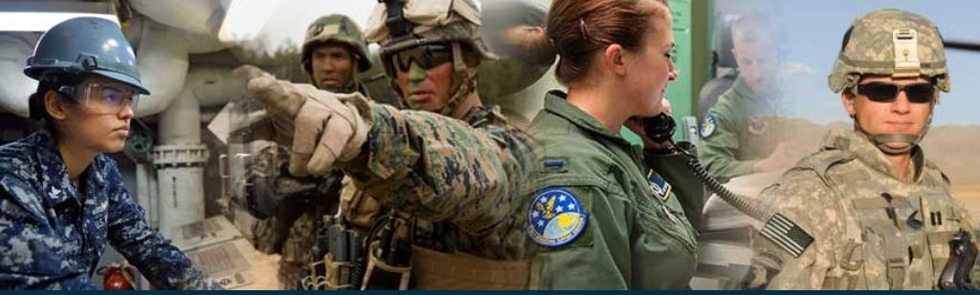
Security as
BUSINESS-ENABLER
Protecting Company Assets
Building Customer Trust
Complying with Regulations
Supporting Innovation
Providing Competitive Advantage

Slide 17
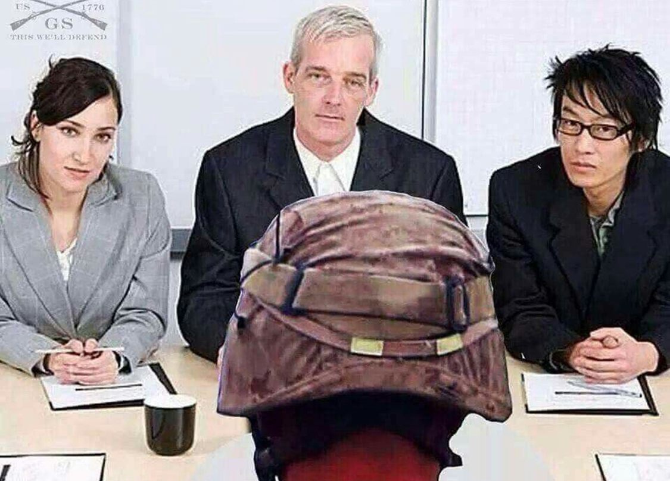
COST CENTRE TO VALUE GENERATION
CHANGING SECURITY PERCEPTION
Strategies to Pursue
Focus on Positive Outcomes
Measure the ROI of Security
Communicate the Risks
Involve Senior Leadership
Leverage Security to Create New Opportunities

Slide 18
Security Management Framework
Mission:
To be an efficient and reliable business partner that supports the sustainability of the company through the protection of its assets.
Governance, Risk Management and Compliance:
Enforce company P&P, and government regulations
Business Resilience:
Provide support in the recovery of business from significant disruptions and disasters
Intelligence and Investigation:
Create and develop intelligence and investigation support
Engagement & Comms
Closely collaborate with business stakeholders
Efficient and Agile Organization
Engagement and Communication
Close collaboration with all business stakeholders and functions of the organizations

Slide 19

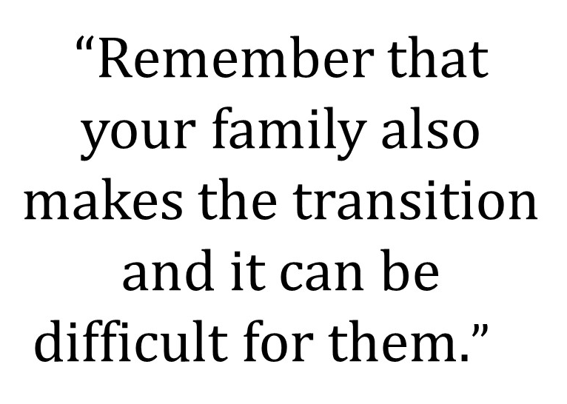

Slide 20
thank you
HERMIE G. COLINA
PMA MAPITAGAN CLASS 1980

